Slide 1
Montalvo University LoadCell overview and troubleshooting
Doug Brockelbank

Slide 2
Introduction
Welcome back to Montalvo University!
Bi-weekly series of technical reviews of Montalvo products, Application Studies, along with Selling and Troubleshooting Tips
The first semester we will be focusing on Load Cells
This Week:
General Product Overview along with basic (or not-so-basic) troubleshooting tips
Future Topics Include:
Identifying opportunities, proper selection and proper sizing
Load Cell manufacturing and quality control
Engineering behind the load cells and design philosophy

Slide 3
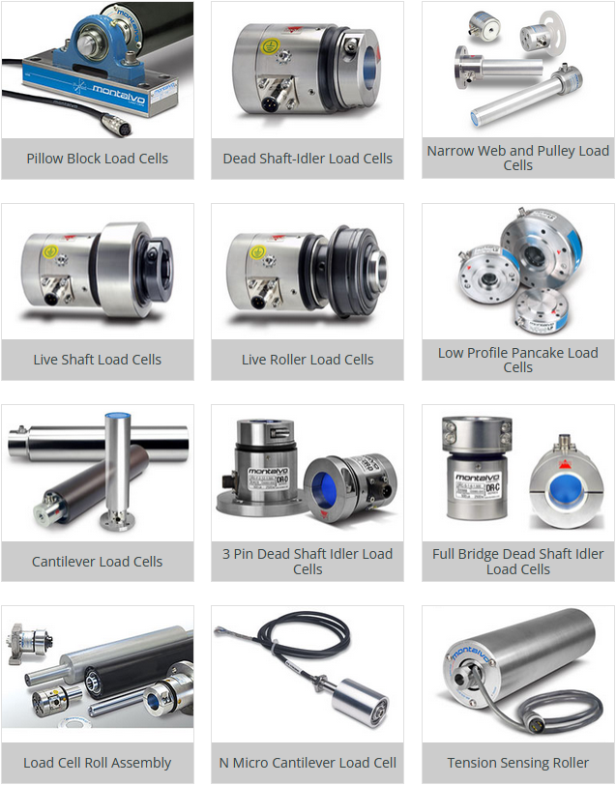
Models and Styles
Notes:
Focus on three specific styles for this discussion, the U-Series, the ES series and the LP series

Slide 4
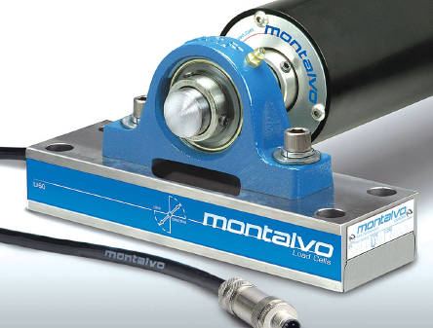
Models and Styles U-Series Under Pillow-block Style
Heavy Duty applications – Harsh Environments Typically High Loads and Tensions

Slide 5
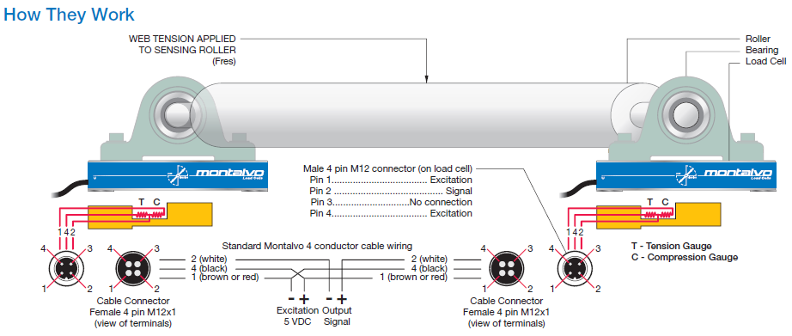
U-Series half-bridge semi-conductor strain gauge. 5-vdc excitation voltage 0-250mV Output Signal per Load Cell Nominal Strain Gauge Resistance approximately 80 to 120 ohms

Slide 6
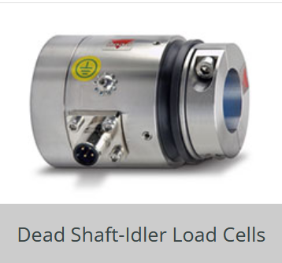
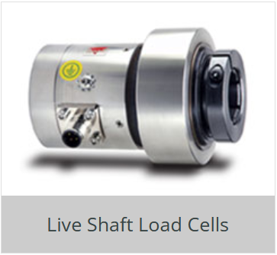
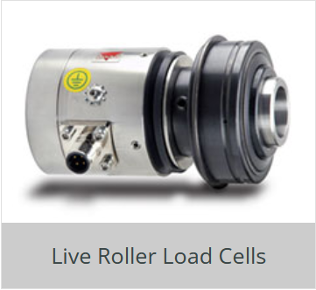
Cartridge style – Our “es” Series Most common style our best selling style Simple, rugged, reliable Easy to install – great for retrofits

Slide 7
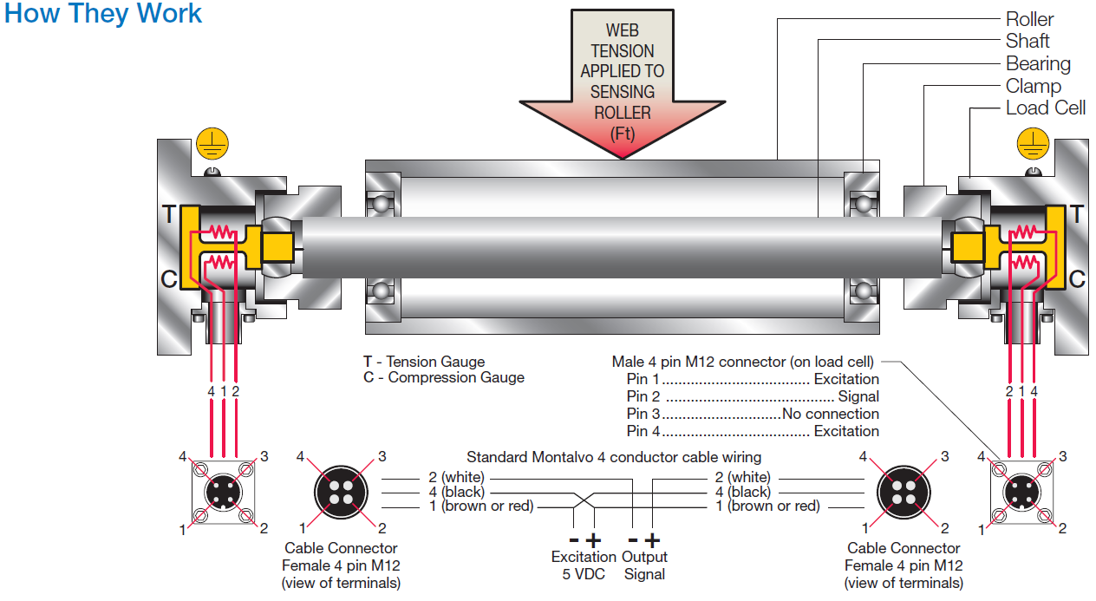
Half-bridge semi-conductor strain gauge 5-vdc excitation voltage 0-250mV Output Signal per Load Cell Nominal Strain Gauge Resistance approximately 80 to 120 ohms

Slide 8
LP or “low profile load cells Full-bridge foil-gauge construction to compete with FMS and e&L Drop-in replacements

Slide 9
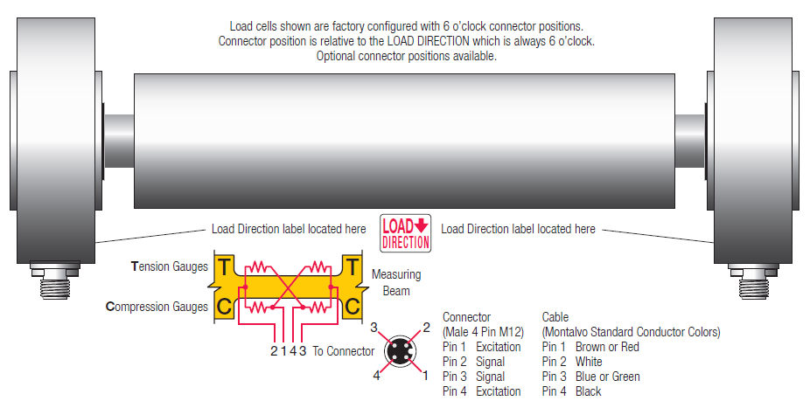
FULL-BRIGE FOIL GAUGE CONSTRUCTION utilizes 10 vdc excitation voltage input and 10mV OUTPUT LOWER SPECIFIC OUTPUT – STABILITY LOWER RESOLUTION Nominal Strain Gauge Resistance approximately 350 ohms

Slide 10
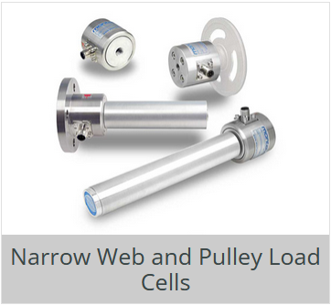
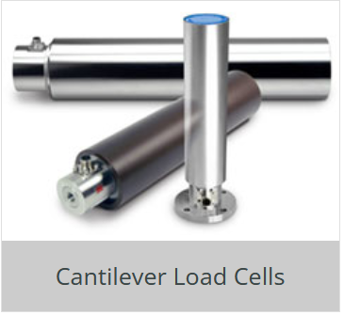
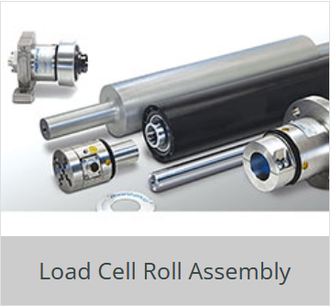
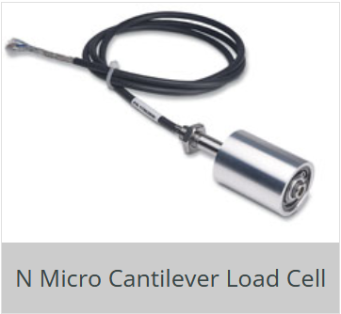
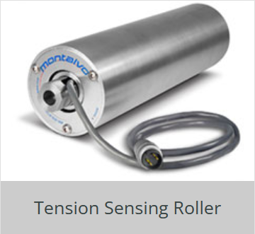
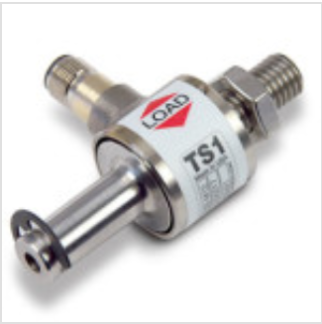
Other styles and configurations all of these styles utilize half-bridge semi-conductor strain gauges

Slide 11
Load Cell Installation Pro Tips to Ensure Success U-Series
Notes:
In terms of technical calls for load cells, particularly new installations, the U-Series and ES series are the most common, and usually related to the installation. Proper attention to the little things prior to and during installation can go a long way to ensuring success – people do not read instructions!

Slide 12
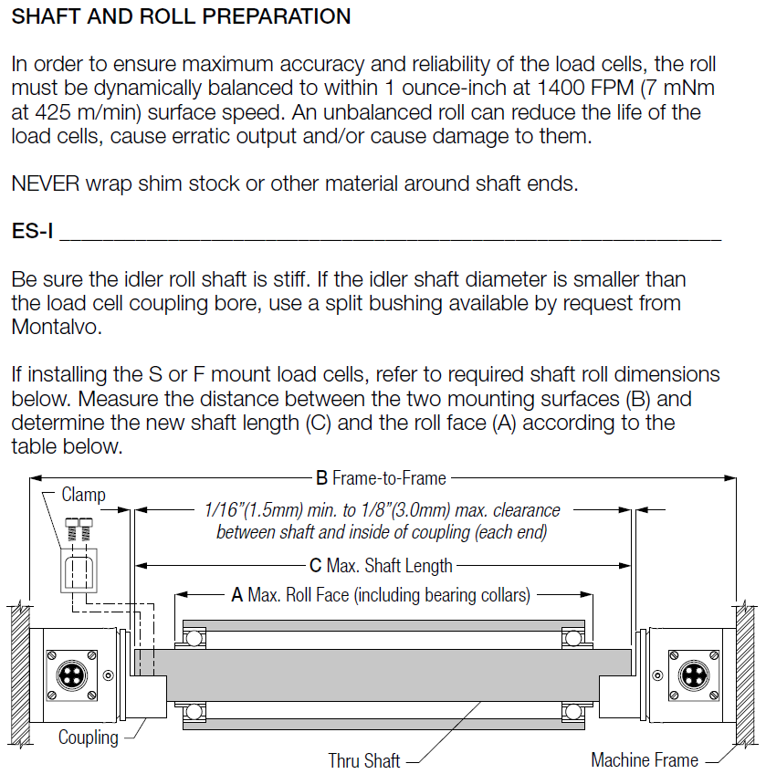
Load Cell Installation Pro Tips to Ensure Success ES-Series

Slide 13
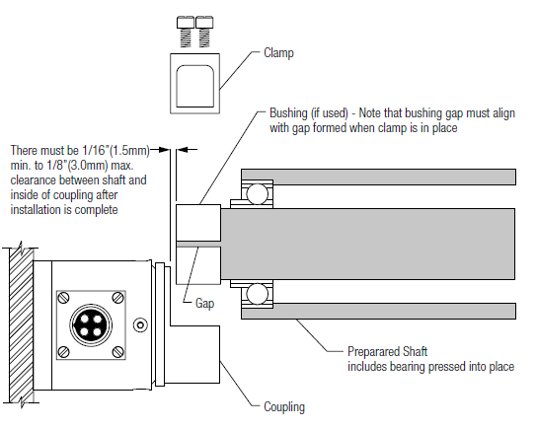
Load Cell Installation Pro Tips to Ensure Success ES-Series

Slide 14
Load Cell Installation Pro Tips to Ensure Success
https://youtu.be/CV2sThaCrZU?si=tCLSBF6bqHp7BsoT
ES Load Cell Installation Video Starring Russ Hall
U Series Load Cell Installation Video
These and other exciting Montalvo Corporation videos can be viewed at the Montalvo Channel on YouTube!
https://youtube.com/clip/Ugkx36jYybovZi_HJOAmS7eBl2sFjTzDf9U_?si=vwF4nZmMiOozRYDA

Slide 15
Managing Technical calls for support related to calibration of load cells
Proper Installation !!!
Establishing “FULL SCLALE TENSION”
It is not generally the load rating of the load cell!
It is a function of the application and what “typical tension” is.
Customers often do not know (hence the reason for the load cells in the first place!
It is key to sizing load cells in the first place. Often the persons installing and calibrating the system do not have this information.
Follow proper Calibration Procedure – Be Consistent
Use appropriate calibration weight (minimum 25% of full scale)
Turn idler rolls in contact with calibration strap at least ½ turn in direction of the weight (this eliminates standing friction between sections of strap between rollers and most closely approximates force seen during normal running conditions.
Notes:
Reason we talked about excitation voltage and specific load cell output in mV is that between this information and nominal gauge resistance, we can perform relatively simple checks of the system to establish if it is a faulty component, or, more likely, an installation issue

Slide 16
managing Technical calls for support related to calibration of load cells (cont.)
Checking nominal gauge resistance of the load cells: Voltmeter set to read OHMS
Load cell wires need to be disconnected from controller or amplifier module
Measure between Black and White wires – between 80-120 ohms
Measure between Brown and White wires – between 80-120 ohms
Difference between the two readings should be less than 6-7 ohms
Out of range reading or Open reading could indicate a bad cell, cable or connector
Checking specific output from the load cells: Voltmeter set to read millivolts (mV)
Load cells need to be connected to the controller or amplifier
Measure between White (signal) wire and common (0 vdc)
Reading should make sense with respect to load rating of the load cell, weight of the idler roll suspended between the load cells, and orientation of the load cells (U- Series) or direction that the load arrow is oriented (ES-Series).
Max output from load cells at 100% load is 250mV
If mV output does not change between unloaded and loaded state, most likely a mechanical issue due to installation – Could also be a bad load cell ☹
Notes:
The reason for using at least 25% of full scale tension for calibration is so that the amplifier circuit can determine and register a large enough difference between zero load and calibration load to establish full range and linearity between min and max values.

Slide 17
In conclusion
Montalvo offers a wider range of load cell styles and configuration to handle just about any web tension indication/control application you will come across.
Montalvo Load Cells are the Class Leader in design, versatility, construction and support
Robust construction using stainless steel for the bodies means long life and reliable performance even in the toughest environments.
Taking the time and care upon initial installation will go a long way to ensuring customer satisfaction and optimal performance for the long haul
Industry leading technical support when needed keeps your customers coming back!

